Slide 1
Join the Revolution!
Build Your Own Social Studies Assessments
Andrew Bell, Ph.D.
CSAI & WestEd

Slide 2
Agenda
Purpose of Set Designs
Set Designs
How to Write Items
Review a Task Set
Practice Writing Task Sets
Review Each Other’s Work
Notes:
30 minutes discussing how to develop high-quality assessment items
review a sample task set for about 5 minutes
write your own task set items in groups for about 30 minutes
remaining time reviewing each other’s work.

Slide 3
Benefits of Rich Engagement in Social Studies
To be productive members of society, students must be critical consumers of information. They:
Use sources regularly to learn content.
Make connections among people, events, and ideas across time and place.
Express informed opinions supported by evidence from sources and outside knowledge.

Slide 4
Purpose of Set-Based Design in Measuring Student Progress
Requires students to apply their historical- thinking analytical skills to answer a set of questions related to a set of questions
Cover themes and content at a deeper level of understanding than stand-alone selected-response items
Focus on application of skills, not recall of facts
Have selected-response items that build to a culminating question
Provides interdisciplinary approach to address GLEs across strands

Slide 5
Item Set Design
Each set will contain:
3 to 4 source documents (e.g., maps, charts, excerpts from primary or secondary source documents)
4 to 7 selected-response items (either multiple choice or multiple select)
Some sets will contain:
1 constructed-response item or 1 technology-enhanced item
In U.S. History all sets will contain technology-enhanced items, and some sets may contain constructed-response items

Slide 6
Task Set Design
Each set will contain:
3 to 4 source documents (e.g., maps, charts, excerpts from primary or secondary source documents)
4 selected-response items (either multiple choice or multiple select)
1 extended-response item (8 points; 4 points in Grade 3)
Extended-response items require students to demonstrate a deeper understanding of a topic than other item types do

Slide 7
Components of Good Set Writing
Set Theme
Sources
Content Alignment
Grade-Level Appropriateness
Item Clarity
Content Accuracy
Bias and Sensitivity
Sources and Items

Slide 8
Set Theme
Think about . . .
The theme of the set
The GLEs to which you will align to the set
Look for opportunities to integrate multiple strands and make connections
Grades 3–8 item sets
Task sets

Slide 9
Set Sources
Think about . . .
The types of sources that will support the theme
How multiple sources will fit together
The grade-level appropriateness of the sources
The potential bias and sensitivity issues in the sources
Notes:
Texts, political cartoons, maps, charts, pictures, statistical tables

Slide 10
Finding Good Sources for Sets
Use a rich variety of sources:
University websites
Online primary-source websites
Government websites
Document collections
Online newspapers
Secondary sources
Avoid:
“.com websites”
Grade-level textbooks
Notes:
Note Library of Congress image bank

Slide 11
Item Writing Components
Importance of Item Alignment
Measures student understanding of what is taught in the classroom
Content Alignment
Define the theme of the set
Items should build toward a culminating topic
Consider the GLEs you want to address
Items must address relevant content in the standards

Slide 12
Item Writing Components
Grade-Level Appropriateness
Use contexts and language that are grade-level appropriate
Avoid the use of complex vocabulary
Use high-frequency words instead of low-frequency words when possible
Item Clarity
It must be clear what the student is being asked to do
Item stem and answer options should be clear
Avoid the use of jargon

Slide 13
Item Writing Components
Content Accuracy
The content of the item must be accurate
There should be only one correct answer (MC)
The distracters should be incorrect and address misunderstandings about the content
Bias and Sensitivity
Item should provide equal opportunity and access for all students
Item must protect the privacy of students
Avoid covering sensitive topics
Avoid providing inappropriate portrayals of groups

Slide 14
Using the Sources with Items
Make sure your items use and reference the sources
Make use of each source at least once in the set
Address specific elements of the sources
Use the sources for distracters

Slide 15
Constructed-Response and
Extended-Response Items
CR
2 points
1 rubric
Short response
ER
8 points
2 rubrics
In-depth response
Does not require examples from sources
Requires lines of reasoning
Requires examples from sources

Slide 16
Writing Constructed-Response and
Extended-Response Items
It is the culminating item of the set, but write it first
Avoid cueing but scaffold from the selected-response items
Clearly formulate item directions and prompts
Use sources and students’ prior content knowledge
Develop achievable tasks

Slide 17
Constructed-Response and
Extended-Response Items
Constructed-Response Item
Based on the sources and your knowledge of social studies, describe two actions taken by the colonists in response to the violations of rights by the British.
Extended-Response Item
Based on the sources and your knowledge of social studies, analyze how European explorers contributed to the trade that developed between the Americas and Europe.
As you write, follow the directions below.
Address all parts of the prompt.
Include information and examples from your own knowledge of social studies.
Use evidence from the sources to support your response.
Follow the steps on the Checklist as you write your response.

Slide 18
Examples of Flawed
Constructed-Response Items
Based on the sources and your knowledge of social studies, explain two reasons why you think the American Revolution began.
Based on the sources, do you think the American Revolution was a good idea?
Based on the sources and your knowledge of social studies, explain how the American Revolution affected the United States in the twenty-first century.
Notes:
Flaw in the first is use of “you”, personalizing response. Flaw in second is similar. Too open-ended, sensitivity question. Flaw in the third is the reference to the 21st century. No basis for comparison. All of the sources are about the Am. Rev.

Slide 19
Examples of Flawed
Extended-Response Items
Based on the sources and your knowledge of social studies, research how European explorers contributed to the trade that developed between the Americas and Europe.
Based on the sources and your knowledge of social studies, why did the European explorers come to the Americas?
Notes:
Flawed first item. Use of “research” as active verb. Flawed second item asking a question, not a statement. Allows for narrow response.

Slide 20
Scoring Rubrics and Scoring Information
Constructed-Response Scoring Rubric
Worth 0–2 points
Extended-Response Scoring Rubrics
Content rubric worth 0–4 points
Claims rubric worth 0–4 points (not in grade 3)
The rubric should match the item requirements
The stem must specifically ask for everything in the rubric
The rubric must clearly differentiate the scoring levels of performance

Slide 21
Constructed-Response Rubric and Scoring Notes
Scoring Notes:
The actions taken by colonists in response to the violations of rights by the British:
• Protest
Boston Tea Party
Speeches such as those made by Hancock, Adams, and Henry in the sources
• Rebel and form an independent government
American Revolution
“all men have a right . . . to leave the society they belong to, and enter into another”
“Give me liberty, or give me death!”
• Accept any other reasonable answer
Scoring Information
Score Points | Description
2 | Student’s response correctly describes two actions taken by the colonists in response to the violations of rights by the British.
1 | Student’s response correctly describes one action taken by the colonists in response to the violations of rights by the British.
0 | Student’s response does not correctly describe an action taken by the colonists in response to the violations of rights by the British.

Slide 22
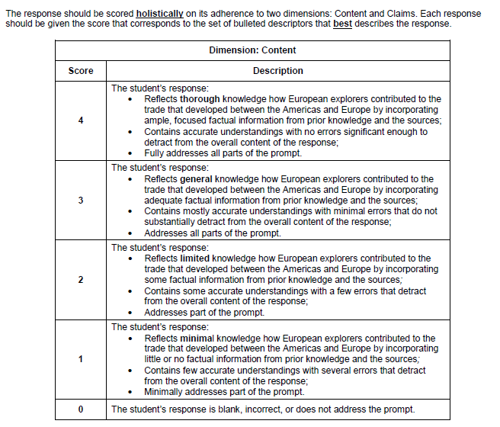
Extended-Response Content Rubric

Slide 23
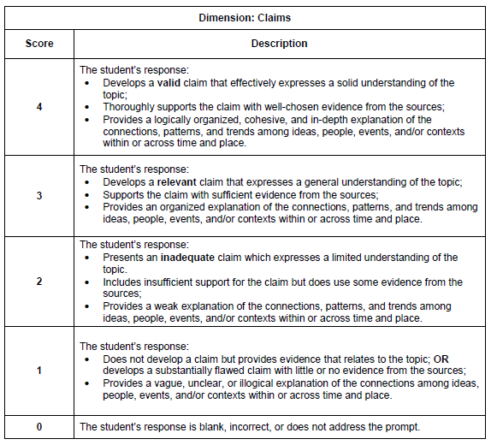
Extended-Response Claims Rubric

Slide 24
Extended-Response Item Scoring Notes
Characteristics of a Strong Response
A strong response is logically organized into several paragraphs. Any errors in spelling, punctuation, grammar, or capitalization do not interfere with the ability of the reader to understand the ideas presented.
A strong response may develop one or more lines of reasoning to support the claim. Here are some examples:
The prospect of acquiring silks, ceramics, and spices in Asia led European explorers to search for new trade routes rather than relying on the eastern trade routes over Central Asia or around Africa. The Spanish conquered all of Central America, Florida, and most of South America. They exploited the local populations and forced them to work as slave laborers to send mineral wealth (silver and gold) and hardwoods to Europe.
The explorations of Europeans in the New World led to the establishment of European empires in the Americas and resulted in what became known as the Columbian Exchange. It unleashed trade between the Americas, Europe, Africa, and Asia in natural resources and consumer goods. The Americas exported plants such as potatoes, tomatoes, tobacco, corn, peanuts, pineapples, vanilla, and cacao to Europe, Asia, and Africa.

Slide 25
Selected-Response Item Types
Selected Response (SR)
1 point
Multiple Choice (MC)
4 Answer Options
1 Correct Response
Multiple Select (MS)
5 to 7 Answer Options
2 to 3 Correct Responses

Slide 26
Writing Selected-Response Items
Strong alignment of item to targeted GLE
Clearly formulated item stem
Purposeful use of source(s)
One correct answer for MC items
Two or three correct answers for MS items
Relevant distracters

Slide 27
Multiple-Choice Item
Source 1
Excerpt from The Rights of the Colonists (November 20, 1772)
by Samuel Adams
Among the natural rights of the Colonists are these: first, a right to life; secondly to liberty; thirdly to property; together with the right to support and defend them in the best manner they can. Those are evident branches of, rather than deductions from, the duty of self-preservation, commonly called the first law of nature.
All men have a right to remain in a state of nature as long as they please. And in case of intolerable oppression, civil or religious, to leave the society they belong to, and enter into another.
Source 2
Excerpt from Boston Massacre Oration (March 5, 1774)
by John Hancock
What tenderness, what regard, respect, or consideration has Great Britain shown . . . for the security of the persons or properties of the inhabitants of the Colonies? Or rather what have they omitted doing to destroy that security? They have declared that they have always had, and should always have, full power to make laws to bind the Colonies in all cases whatever. They have exercised this pretended right by imposing a tax upon us without our consent. And in case we show some reluctance at parting with our property, her fleets and armies are sent to enforce their mad claims.

Slide 28
Multiple-Choice Item
Which phrase from Source 1 or Source 2 is most closely associated with the rights that colonists believed they were guaranteed as citizens?
“a right to life; secondly to liberty; thirdly to property; together with the right to support and defend them” (Source 1)
“evident branches of, rather than deductions from, the duty of self-preservation” (Source 1)
“they have always had, and should always have, full power to make laws to bind the Colonies in all cases whatever” (Source 2)
“exercised this pretended right by imposing a tax upon us without our consent” (Source 2)
Notes:
A is the correct answer. Emphasize connection between the item and the sources. Focus on the clearly formulated stem. Key is A.

Slide 29
Multiple-Select Item
Using all of the sources, which acts by the British government caused discontent among the colonists?
Select the two correct answers.
requiring the colonies to join a confederation
quartering of soldiers in private homes
placing import duties on certain goods
offering rewards for capturing suspected rebels
encouraging farming of crops like tobacco
taxing the colonies without their approval
Notes:
Keys are B and F. Note the second sentence that tells the student to select two answer options.

Slide 30
Don’ts of Writing Selected-Response Items
Avoid . . .
Cueing between the item stem and answer options
Outliers in the answer options
Implausible distracters
Use of the word “not”
Use of the words and phrases “all,” “none,” “always,” “never,” “all of the above,” and “none of the above”
Use of opposites in answer options

Slide 31
Examples of Flawed Selected-Response Items
Based on Source 1, which statement best describes a cause of the American Revolution?
The American colonists wanted to have a big party.
The American colonists believed they were unfairly governed.
The American colonists started the American Revolution to gain land.
The American colonists wanted the same rights as British citizens.
Notes:
Flaws: A is implausible. B is an outlier with the adverb. Only one without cap letter. C is cued by the stem “American Revolution”. D is also possibly correct.

Slide 32
Examples of Flawed Selected-Response Items
How will an increase in producers affect the supply of sugar?
The price will always go up.
The price will decrease.
The price will not change.
Consumers will buy less.
Notes:
Flaws: opposites in answer options. Use of “always”. Use of “not”. Answer option D is an outlier. Technically, no correct answer.

Slide 33
For more information please contact:
Presenter Andrew Bell
abell@wested.org
www.csai-online.org
This document is produced by the The Center on Standards and Assessment Implementation (CSAI). CSAI, a collaboration between WestEd and CRESST, provides state education agencies (SEAs) and Regional Comprehensive Centers (RCCs) with research support, technical assistance, tools, and other resources to help inform decisions about standards, assessment, and accountability. Visit www.csai-online.org for more information.
This document was produced under prime award #S283B050022A between the U.S. Department of Education and WestEd. The findings and opinions expressed herein are those of the author(s) and do not reflect the positions or policies of the U.S. Department of Education.

