Slide 1
Kick-off with SEA Teams
Determine Impact of Prior Investments
November 9, 2023

Slide 2
The presentation is prepared by the National Comprehensive Center under Award #S283B190028 for the Office of Program and Grantee Support Services (PGSS) within the Office of Elementary and Secondary Education (OESE) of the U.S. Department of Education and is administered by Westat. The content of the presentation does not necessarily reflect the views or policies of the Office of Program and Grantee Support Services (PGSS), the Office of Elementary and Secondary Education (OESE), or the U.S. Department of Education nor does mention of trade names, commercial products, or organizations imply endorsement by the U.S. Government.

Slide 3
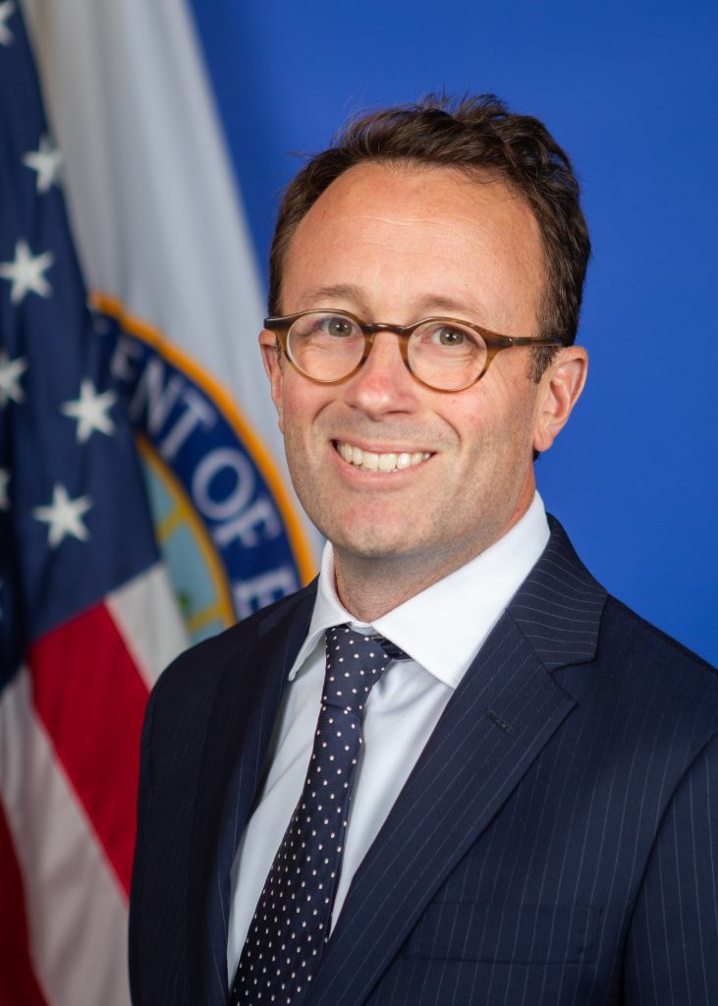
Welcome from the U.S. Department of Education
Adam Schott
Acting Assistant Secretary
Office of Elementary and Secondary Education
Notes:
Adam

Slide 4


The National Comprehensive Center and the CCNetwork work with SEAs and LEAs to...
Improve education opportunities
and outcomes for disadvantaged
and low-income students
Increase awareness and use of evidence-based practices related
to school improvement
Enhance human, organizational, policy, and resource capacity
Check out the CCNetwork website!
http://compcenternetwork.org
Notes:
Jill

Slide 5
Overview of the Strategic Planning for Continued Recovery Initiative
Strategic Planning for Continued Recovery (SPCR) offers supports to state and local education agencies (SEAs and LEAs) to sustain high-leverage strategies, funded by American Rescue Plan and other COVID-relief funds.
We will use the six strategies outlined below throughout the initiative:
We will also identify how SEAs might use five levers (Grantmaking, Policy, Monitoring, Technical Assistance, and Partners) as they engage in their own planning and support LEAs around these strategies.
Determine impact of investments
Prioritize efforts for ongoing recovery & transformation
Achieve sustainability through financial planning
Ensure access & opportunity for all
Communicate impact of investments
Support/sustain systemic capacity building
Notes:
Jill
As the timeline for the use of COVID recovery funding comes to a close, there is an ongoing need for SEAs and LEAs to reflect on and gauge the effectiveness of their recovery strategies.
Today is the first of 6 webinars that will be available to your SEA team. Part of the Strategic Planning for Continued Recovery initiative, these six strategies will anchor our early learning efforts. <Read each title.> Each of these webinars will be accompanied by a resource portfolio for your on-demand use.
While there are many levers an SEA can use to support LEAs – five will be identified across the resource portfolio and include grantmaking, policy, monitoring, technical assistance, and partnerships.
Since the majority of COVID recovery funds are allocated to LEAs, the SPCR has a heavy focus on supports SEAs can provide to their LEAs to support sustainability of their investments. We encourage SEAs with unitary status to apply the strategies/resources indicated for LEAs to the appropriate context within their SEA.

Slide 6
Each SEA can customize their “SPCR pathway” to meet their needs. Here are some possibilities.
 | Universal webinars | Resource Portfolios | Individual SEA Consultation | Cross-SEA Team Collaboration (one-time) | Individual SEA Coaching | Cross-SEA Team Collaboration (ongoing) | Independent work
SEA Team 1
SEA Team 2
SEA Team 3
SEA Team 4
Create Your Own Path
Notes:
Jill
Depending on where your SEA is in its planning, you can explore these strategies in more detail through SPCR-sponsored webinars, resource portfolios, cross-SEA collaboration opportunities, and individualized coaching ((Register your SEA Team to participate on the CCNetwork website!).
Each SEA team will have the opportunity to customize your learning pathway. Here are some illustrative examples:
<click>
1: <read>
Or a team might choose to engage in independent work in the spring and summer
In Pathway #3, this team attends the webinars, works/plans independently, but seeks to join a targeted community of practice in order to access peer expertise and financial expertise.
The fourth pathway is an independent learning pathway.
And of course we are happy to help you chart your own course and assist you in identifying the right supports for your team.
Regardless of which pathway your team creates, we look forward to helping you document the products and processes used so that you can build and sustain your own team's capacity and share examples with others. To help with this, we are also offering templates to support your work for each of the six strategies. We will release new templates to coincide with each webinar, so stay tuned!

Slide 7
The Strategic Planning for Continued Recovery supports are varied
Nov. 9 Nov. 30 Dec. 6 Jan. 11 Feb. 1 Apr. 4 Summer ‘24
Universal Webinars &
Resource Portfolios
Determine impact of investments
Prioritize efforts for ongoing recovery & transformation
Achieve sustainability through financial planning
Ensure access & opportunity for all
Communicate impact of investments
Support/sustain systemic capacity building
Individualized Supports
Individual SEA Coaching
Individual SEA Consultations
Individual SEA Consultations
Targeted Supports
We are planning to offer targeted opportunities for cross-SEA team collaboration starting in late fall 2023 and continuing into 2024. The nature and frequency of these targeted supports will be informed by needs identified through SEA team individual consultations.
Notes:
Jill
In addition to the universal webinars and aligned resource portfolios, there are other supports:
Individual team consultation conversations following webinars
Individual team coaching with finance experts
Targeted opportunities for SEA Teams to engage in cross-SEA collaboration – more details to come soon!

Slide 8
Determine Impact of Prior Investments
Notes:
Jill
Today, let's begin with the focused content to Determine Impact of Prior Investments.

Slide 9
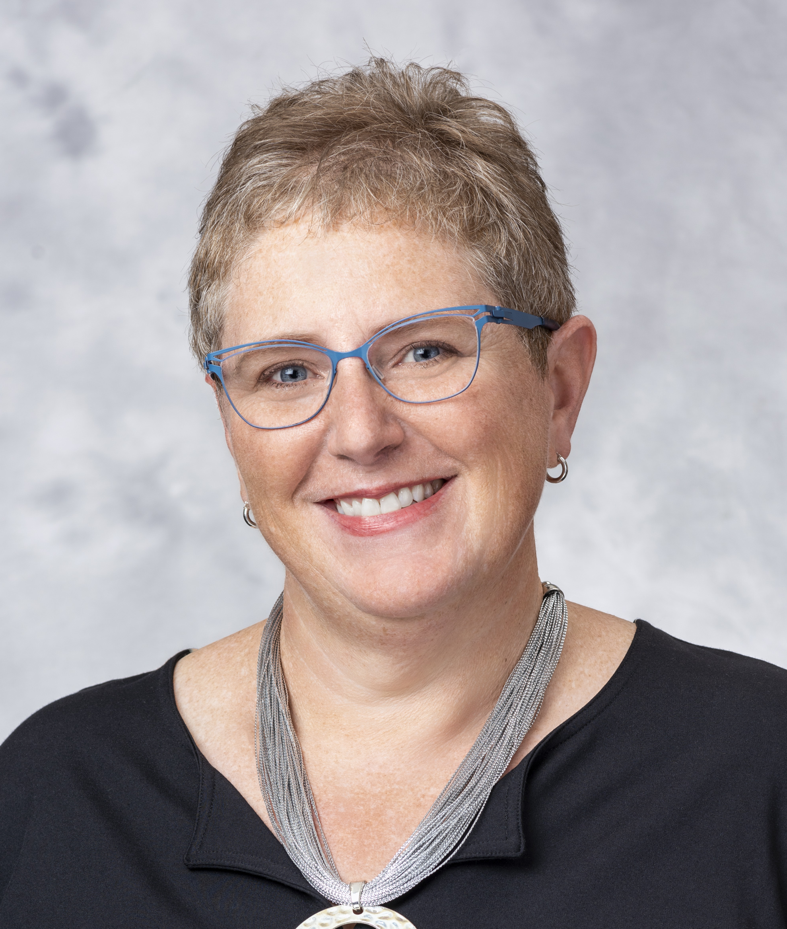
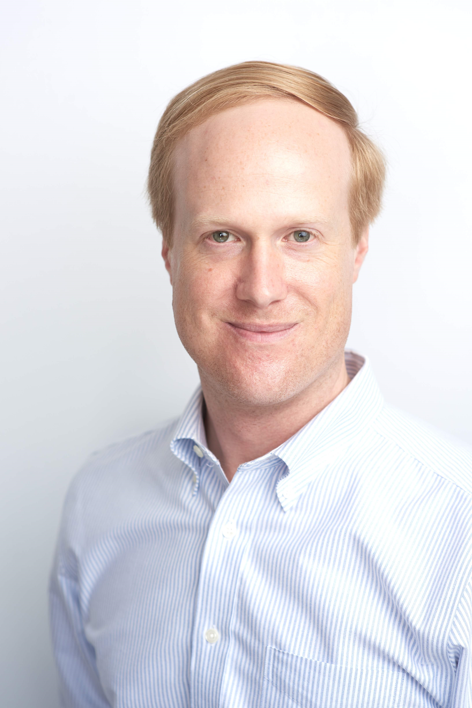

Presenters
Barbara Crock
National Comprehensive Center
Jack Schwarz
National Comprehensive Center
R7CC Co-Deputy Director
Ventura Rodriguez
Education Resource Strategies
Notes:
Jill
Our presenters today are Dr. Barbara Crock and Jack Schwarz, from the NCC team. Jack also is Co-Deputy Director of R7CC. They are joined by Dr. Ventura Rodriguez from NCC partner Education Resource Strategies (ERS). They will share strategies and tools to help you Determine Impact of Your Prior Investments.

Slide 10
Today we're going to focus on how SEAs can determine the impact of their, or their LEAs’, investments
QUESTIONS FOR SEA TEAM CONSIDERATION
Which evidence-based interventions were selected and implemented?
What is the theory of action or logic model for each intervention?
  How do the resources/inputs, activities, and outputs connect to produce the expected outcomes?
What data are being tracked to determine if the intervention will achieve the expected outcomes?
How are the SEA and LEAs communicating priorities, investments, and current progress to various interested parties?
Notes:
Barb
Today as we focus on how State Education Agencies can support schools and districts to determine the impact of their investments. To do so, there are several questions your team may consider:
Which evidence-based interventions were selected and implemented?
What is the theory of action or logic model for the intervention?
What data are being tracked to determine if it is meeting expected outcomes?
How are we all communicating about these investments?
And as I say "we" - I invite you consider who the “we” actually is … Who is in the room contributing information and making decisions about the impact of the interventions? And how can we be intentional and more equitable in who we gather together to answer these questions?

Slide 11
Here's what we plan to accomplish today:
Understand levers SEAs can use to support LEAs in determining impact
Identify at least one strategy or resource SEA teams can use to strengthen their support for LEAs in determining impact of their investments
Consider how the needs and desired supports related to determining impact of investments shared by today's LEA presenters might apply to your SEA context
Notes:
Barb
With these questions in mind, we invite you reflect on your efforts, recognize the levers you have been using to support schools and districts, identify one strategy or resource to strengthen this support, and to consider how the needs and desired supports for determining impact are changing based on the context of today.

Slide 12
Agenda
Five SEA Levers to Support LEAs
SEA Efforts to Determine Impact
Spotlight on LEA Practice: Metro Nashville Public Schools (TN) & Lubbock ISD (TX)
Resource Portfolio: Tools to increase your support of LEAs
Invitations and Opportunities
Notes:
Barb
During our time together, we will review five levers that State Education Agencies can use intentionally to provide support to your schools and communities. Please have your phone or computer at hand. After getting a little more context from you all, we will then focus on efforts states are currently using to determine impact and share tools that you might use. This will be informed by leaders from Metro Nashville Public Schools and Lubbock Independent School District. We'll conclude by sharing invitations and opportunities for deeper learning.

Slide 13
Five SEA Levers to Support LEAs
Notes:
Jack
Throughout the SPCR initiative we'll highlight a selection of levers SEAs can use to assist LEAs in sustaining effective interventions.

Slide 14
Throughout this webinar series, we will be focusing on key levers SEAs can use to support their LEAs as they implement the different focus strategies.
Grantmaking
Monitoring
Policy
Technical Assistance
Partnerships
Notes:
Jack
Throughout the SPCR initiative we will highlight levers SEAs can use to assist LEAs in sustaining effective interventions.
You'll be able to recognize the levers by the icons you see on the screen. Today we'll be focusing on how SEAs can use their existing grant, policy, monitoring, technical assistance, and partnership efforts to help LEAs determine the impact of prior investments.
A few illustrative examples.
An SEA uses their grant authority when structuring LEA consolidated applications.
Their monitoring authority when requesting and analyzing data from LEAs.
Policy when setting rules for the selection of evidence-based interventions.
Technical assistance when designing and delivering professional development for LEAs.
And partnership when collaborating with internal offices or outside vendors.

Slide 15

In your role, which of the five SEA levers for supporting LEAs do you currently leverage the most?
Grantmaking
Policy
Monitoring
Technical Assistance ​
Partners
http://www.menti.com/alt1muqi9dex?source=qr-page
Mentimeter QR Code
Notes:
Jack
To start, however, we want to hear the lever that you, in your role, utilize most when supporting LEAs.

Slide 16
Based on the evidence you have, which ARP | ESSER | ESF investments made by your LEAs should be sustained to support continued learning recovery?
Notes:
Jack
Based on what you know now, which investments made by your LEAs are needing to be sustained to promote continued acceleration of student learning?
ARP, ESSER, or in the case of our unitary systems – Education Stability Funds

Slide 17
What evidence are you using to determine which LEA investments to continue?
Rate of spending
Return on investment – financial and programmatic data
Change in student outcomes (e.g., increased test scores and graduation rates)
Positive short-term outcomes and leading indicators (e.g., increase in student attendance and engagement)
Educator workforce data (e.g., staff recruitment/retention)
Alignment of implementation to evidence-based practice
Other
Notes:
Jack
Finally, we'd be interested to know what evidence you are using to determine which investments need to be continued?
Select multiple

Slide 18
SEA Efforts to Determine Impact
Notes:
Barb
So how can state education agencies support local educational agencies s to determine the impact of their investments?
Or if you are in a member of a unitary system … How can you determine the impact of your schools’ investments?
Let’s learn from the current efforts of others. While the monitoring lever may seem the obvious choice, we will argue many levers can be integrated to strengthen your approach.

Slide 19




It's essential to move beyond just monitoring the pace of spending
Pace of Spending
Student
Outcomes
Investment
Inputs, Outputs, and Outcomes
Communicate and Scale Effective Investments
Notes:
Barb
Looking across the national landscape … we see state education agencies taking varied approach. It’s essential to move beyond monitoring the pace of spending and so we offer this formula to determine outcomes. In addition to monitoring spending, consider student outcomes, the specific investments made in the intervention so that – if the intervention is effective - we can communicate, scale and make informed sustainability decisions.

Slide 20
When looking at pace of spending, the monitoring lever might be particularly useful
Pace of Spending
Dashboard with public spending data
LEA communications with embedded spending reports
Data requested from LEAs to include in the ESSER Annual Performance Report
Notes:
Jack
SEAs can help LEAs track the pace of their ESSER spending through their monitoring authority, for instance . . .
Publishing a public dashboard on their website – we'll see an example on the next slide
Sending regular reports to LEAs tracking drawdown of funds and communicating key messages, for instance, providing guidance around sustainability for districts that have spent most of their recovery funds
Collecting data from LEAs – for instance, the spending on certain interventions - to support the submission of the SEA's ESSER Annual Performance Report

Slide 21
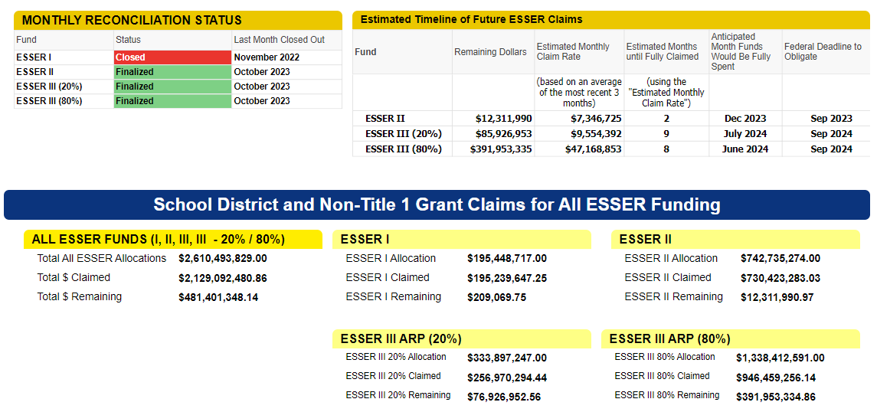
The Washington SEA is monitoring the pace of LEA spending through a public dashboard
Source: https://app.smartsheet.com/b/publish?EQBCT=73a2ba95e92b45d0b89eb8dc29d25f92
Notes:
Jack
Here is an example of an ESSER spending dashboard.
You'll notice Washington state tracks LEA funds claimed and remaining . . . and breaks out the ARP local 20% set-aside for learning acceleration.
This is the statewide dashboard but each district has a page showing similar information.

Slide 22

SEAs can use different types of monitoring to examine whether student outcomes are improving
Student
Outcomes
LEA outcomes disaggregated over time
Data reports looking for progress over time
Annual Performance Report data used to track eligible students who are not receiving support
Notes:
Jack
The second part of our formula is tracking student outcomes. SEAs might use their monitoring authority to, for instance:
Look at disaggregated LEA outcomes over time, particularly to identify groups of students that are in need of learning acceleration
Prepare data reports, for instance, to identify districts that have shown the most/least improvement . . . and inform the design of differentiated technical assistance
And finally, SEAs can use data they collect from districts to track students eligible for interventions that are not receiving support

Slide 23
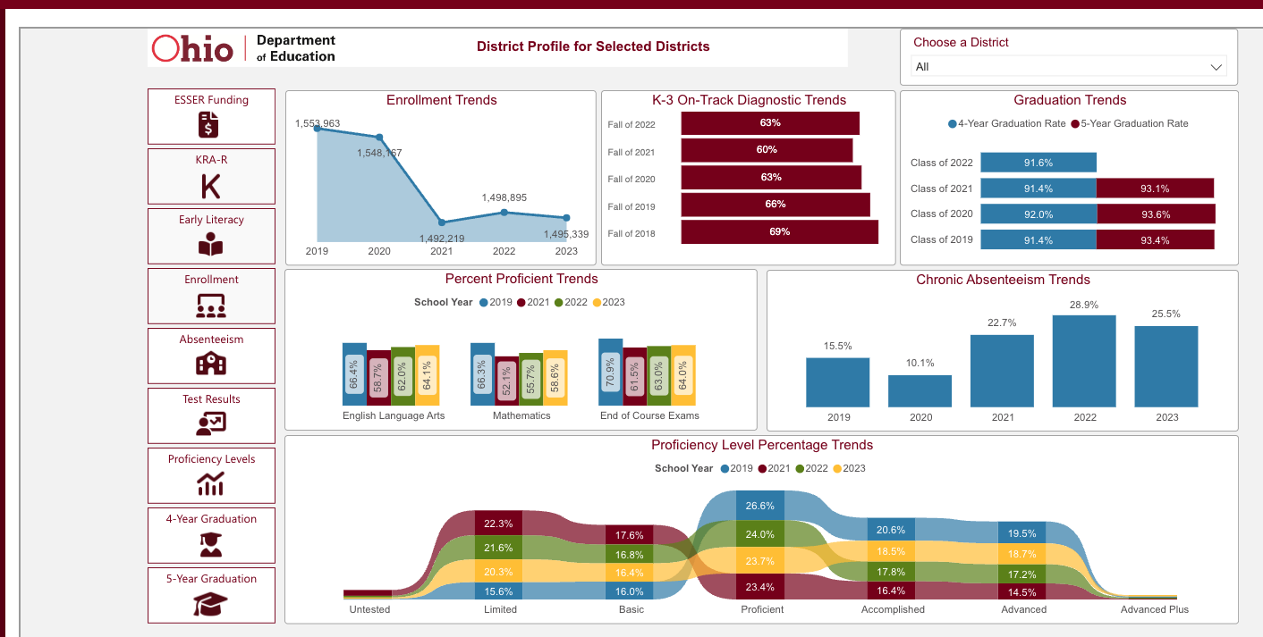
Ohio visually communicates key outcomes over time through an LEA dashboard
Source: https://reports.education.ohio.gov/report/report-card-data-district-dashboard
Notes:
Jack
Here is a dashboard from the Ohio Department of Education that shows trends in enrollment, proficiency, chronic absenteeism, graduation, and K-3 diagnostics.
Each district has its own profile tracking these trends.

Slide 24
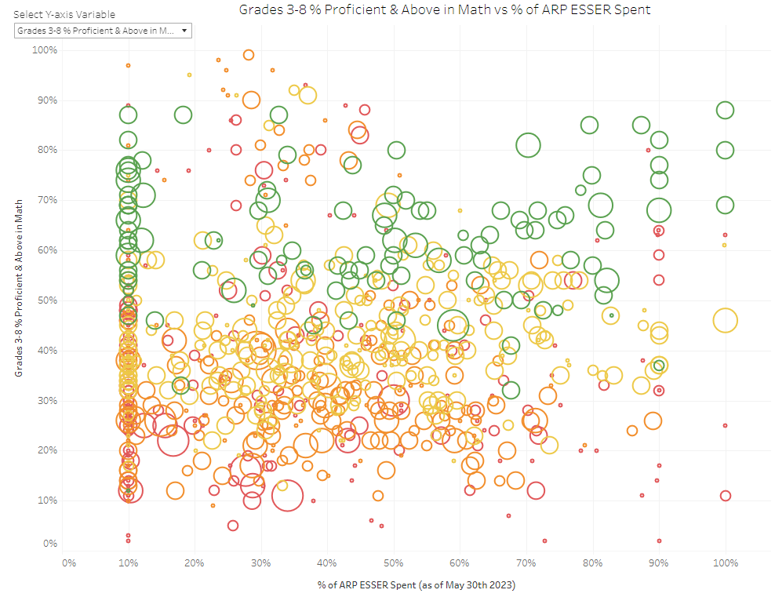
SEAs are using visualizations with spending and outcomes to inform decisions.
Source: https://public.tableau.com/app/profile/edunomicslab/viz/NYARPCoP_WIP/NewYorkStateARPCoP
Notes:
Jack
SEAs are also using visualizations to track both spending and outcomes. This is an internal tool that our partner Edunomics Lab created for New York showing %ARP spent vs proficiency+ in ELA and Math for tested grades.
<CLICK> The size and color of the circle you see here indicates this district serves a comparatively large number of students and over 75% are economically disadvantaged. Based on its placement on the graph, we can see that it has spent slightly less than 20% of its ESSER funds and that student proficiency for tested grades in ELA and math is slightly greater than 20%
<CLICK> In comparison, this other district is smaller and has fewer economically disadvantage students. Based on its placement, this district has spent approximately 45% of their ESSER funds and students are scoring about 85% proficient+ in combined ELA and math.

Slide 25

SEAs can use the levers of monitoring and partners to understand implementation and impact
Investment Inputs, Outputs, and Outcomes
Work with selected LEAs to understand the intent, document the logic model, and assess the implementation of specific investments
Partner with an outside evaluator or SEA department to document implementation and evidence of impact
Notes:
Barb
As we get curious about particular schools or school systems, the next step to determine impact is to use the levers of monitoring and technical assistance to understand and evaluate impact.
Whether it is you, a member of another department on your team, or an empowered partner, we need to deeply understand the intent, document the logic model, and assess the implementation of specific interventions. We all know that context matters, so understanding how High Dosage Tutoring is working – not just in one, but several different contexts - will help to inform decisions.

Slide 26
The Puerto Rico Department of Education is determining impact of its RAE (extended day) program
Inputs | Activities | Outputs | Outcomes
 |  |  | Short-term (1 yr) | Mid-term (2-3 yrs) | Long-term (4-5 yrs)
ARP/ ESSER funding Orientation structures/ supports Performance monitoring tools/ processes Staff time Staff expertise Wraparound service delivery (lunch, transportation, etc.) | Recruitment campaigns | # of schools (n=627) # staff recruited (93% of goal) # of new targeted students (n=64,149) # community outreach activities | Increased awareness and understanding of RAE program supports and requirements Increased school staff involvement in RAE Increased recruitment of certified teachers and qualified support staff for RAE and regular day programs | Increased availability of RAE program across schools Improved instructional practice in RAE and regular day programs | Improved student wellbeing Improved student performance on META-PR
 | ORE & School-level structures & supports | Curriculum, instructional coaching Instructional PD/training/ co-planning | Better teacher understanding of social emotional learning (SEL) strategies Better teacher understanding of how to help students answer standardized tests | Increased teacher use of SEL strategies Increased teacher use of strategies to help students answer standardized tests during instruction
 | Engagement activities | # of students participating in engagement activities % student attendance in engagement activities | Increased awareness of and engagement in RAE activities Enhanced national pride, motivation, and sense of accomplishment Increased student participation in learning acceleration activities Increased student attendance in regular day school | Improved student performance on formative assessments in Spanish Reduced learning loss for targeted students Increased student application of strategies to answer standardized tests
 | Recreational/ extracurricular activities | # of students participating in recreational activities % student attendance in recreational activities
 | Learning acceleration activities | # of students receiving targeted learning instruction interventions % student attendance in learning acceleration activities
Notes:
Barb
The Puerto Rico Department of Education is using a logic model tool to clarify the implementation and monitoring components for their Programa RAE or their extended day program. There is increasing clarity about what are inputs, activities, and outputs and how these efforts lead to outcomes.
On the right hand side, you will notice that there are 3 columns of outcomes – short-term, mid-term, and long-term. While many of the interventions being used by our schools are anticipated to have a long term effect, we need to focus on documenting the short and mid-term outcomes now. These are the leading indicators of impact.
While you might use this type of tool with a school or agency you support, you can also use it for your own programs and initiatives. California is asking its own internal grant programs to document their theories of action . They have worked with the National Center, Regional Comprehensive Center 15, and REL West to support their internal capacity to understand and communicate the impact of their grants.

Slide 27




To support communication and scaling of effective investments, consider using technical assistance, policy, and/or grantmaking
Communicate and Scale Effective Investments
Spotlight LEA efforts in communications, convenings, case studies, or resource guides
Identify a "north star" or "guardrail" within policy or school improvement structures based on effective implementation
Create targeted grant opportunities to scale
Notes:
Barb
Once we fully understand the implementation of the intervention and its impact, we can make important decisions to communicate, scale, and sustain efforts.
State teams can spotlight school-based efforts. You can also identify a "north star" to set or hold a direction for state-wide efforts, at times inserting it explicitly into policy, and/or creating targeted technical assistance and grant opportunities to scale.

Slide 28
These SEAs have set legislative agendas based on finding the positive impact of investments
Texas | House Bill 3 | Additional Days to the School Year
Texas | TXPOST | Advocates for high-quality OST programming
Oregon | HB 3144 | Student success plans for Pacific Islander students
Oregon | HB3198 | Early Literacy Success Initiative
Minnesota | HF2497 | Funding with mandates for schools Includes and defines "evidence-based literacy instruction" Includes Grow Your Own programs
Notes:
Barb
Other states are also considering policy implications based on having determined impact. We see Texas adding days to the school year and advocating for high quality out of school time programming. Oregon is identifying specific students who need additional assistance. Minnesota's current efforts include Grow your own programs to support workforce development.
[Note: TXPOST – Legislative agenda link]

Slide 29
Spotlight on
LEA Practice
Lubbock ISD
Metro Nashville Public Schools
Notes:
Jack
In this section we're excited to spotlight two LEAs – Lubbock ISD in TX and Metro Nashville Public Schools in TN – and their experience tracking the outcomes of their investments.
Ventura, from our partner ERS, will facilitate the discussion.

Slide 30


Our panelists today are…
Sarah Chin
Chief Strategy Officer
Metro Nashville Public Schools
Misty Rieber​
Chief Academic Officer​
Lubbock Independent School District
Notes:
ERS to lead panel discussion. Key prompts: What is an example of an intervention that has accelerated learning? How did you determine impact? How could your SEA best support your work?

Slide 31


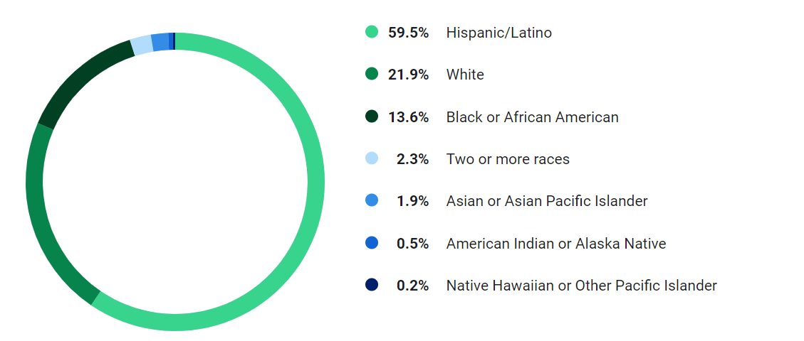
Lubbock ISD serves a diverse student population
District Profile:
26,304 Students
72.6% Economically Disadvantaged
12.8 % Students with Disabilities
5.4% English Learners
Budget: ~ 241 million
10 Years of Declining Enrollment
Staff Members – 3,428
2,828 Instructional and related services
433 Instructional and school leadership
364 Support Services
Campuses – 48
29 elementary schools
9 middle schools
4 high schools
4 alternative campuses
2 special purpose campuses
Talkington School for Young Women Leaders (grades 6-12)
Notes:
Changed organizational culture and how district leaders collaborated cross-departmentally which gave Academics and Finance a feeling of shared ownership over the budget
Used process to build a bridge with Academics
Facilitated a process for leaders to have difficult, student-centered conversations around resources trade-offs, where decisions were less personal and more focused on student impact
Built transparency in decision-making and allowed teams to set proactive evaluation metrics which led to discontinuing ineffective programs and created buy-in to maintain effective programs
Gave the team increased visibility into what the team said they were going to do and asking if it is it having the effect? E.g. Investing in Employee compensation –are we did we have a drop in resignations?
Used standing meetings to find time to invest in this process
Expanding SSROi to other areas and building the capacity across the system - We are going to do ROI training with our principals

Slide 32

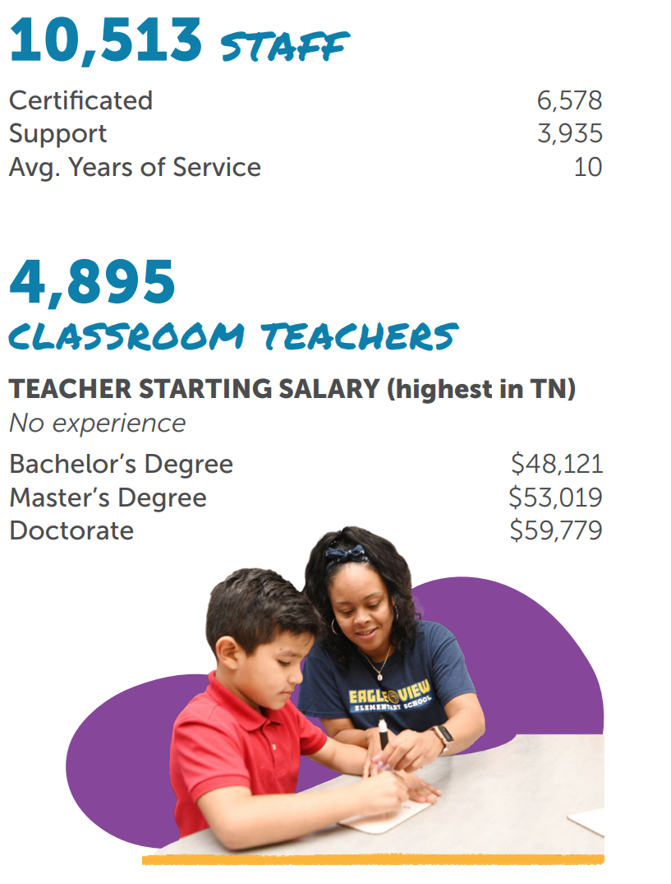
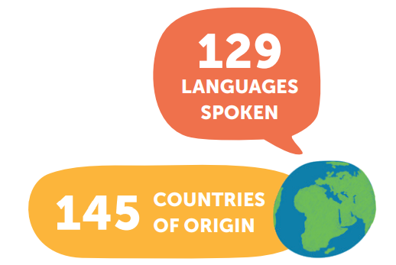
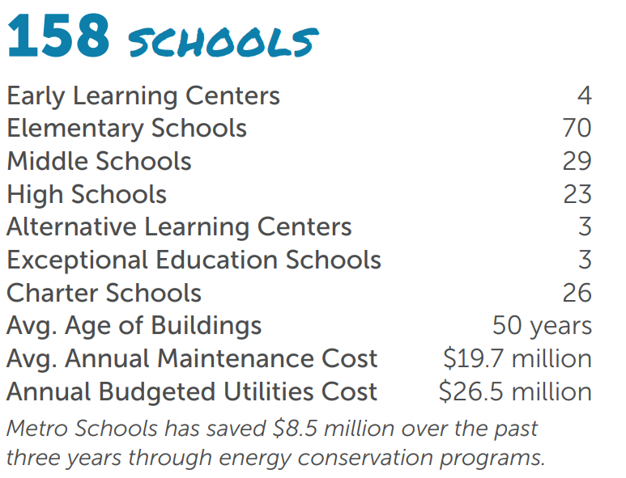
MNPS is one of the largest districts in Tennessee and serves a diverse student population
Source: MNPS Fact Sheet 2022-23 https://cdnsm5-ss13.sharpschool.com/UserFiles/Servers/Server_32970243/File/About/MNPS-FactSheet_2022-23.pdf
Notes:
Part of what we all do at the beginning of the project will be get familiar with Nashville's context as a district. We'll start that off today with some "by the numbers" facts.
Two interesting things here that are different in Metro Nashville Public Schools than in most Tennessee school districts are the size – Nashville is the second largest in the state after Shelby County Schools in Memphis – and the amount of English learners – the share of students learning English and the range of different languages they speak is higher than usual for the state.

Slide 33
Resource Portfolio
Tools to increase your support of LEAs
Notes:
Barb
Thank you, Ventura, Sarah, and Misty, for sharing a local education agencies perspective and naming the supports that are needed at this time.
In our final minutes together, we want to challenge you to think about how you can increase your support for schools, districts, and organizations to determine impact. All of the resources we will discuss are available in the SPCR Resource Portfolio, the link to that page is in the chat.

Slide 34
The Challenge:
Add one tactic to enhance your efforts to support LEAs
Pace of Spending
Student
Outcomes
Investment
Inputs, Outputs, and Short- / Mid-Term Outcomes
Communicate and Scale Effective Investments
Notes:
Barb
So, we challenge you and your team to add one tactic to your current efforts to support LEAs.... [Especially now]

Slide 35
Determining impact of interventions now gives you time to influence policy and budgetary decisions
ESSER obligation deadline!
SEPT | OCT | NOV | DEC | JAN | FEB | MAR | APR | MAY | JUNE | JULY | AUG | SEPT
2023 |  |  |  |  |  |  |  |  |  | 2024
State legislative sessions
SEA
1st Board budget work session
Examine data, Set priorities
2nd Board budget work session
Quantify and narrow options
Final board vote on 24–25 budget
2024–25 School Year Begins
LEA
Source: Adapted from Edunomics Lab, Wild Ride Ahead, 2023
Notes:
Barb
ESPECIALLY NOW …. As we are all aware, ESSER III funds are to be obligated by September 2024 and state legislative sessions and schools are anticipating policy and budgets in the upcoming months that will inform practice beyond that ESSER III funding for the2024-2025 school year. If we wait until April – May- or June to determine impact of our current investments, we will have missed the window to use the data and information to influence the structures and systems for the next school year.

Slide 36

Support LEAs that are not on track to spend all their funds with evidence-based actions
Identify which LEAs are…
On track to spend and have strong tracking systems in place
On track to spend but don’t have strong tracking systems in place
Not on track to spend but have strong tracking systems in place
Not on track to spend and don’t have strong tracking systems in place
Pace of
spending
Source: 10 Ways to Spend Remaining ESSER Funds, Education Resource Strategies
Notes:
Jack
First, for those SEAs tracking pace of LEA spending . . .
<click> We encourage you to support districts that are not on track to spend . . . to make investments that maximize the remaining ESSER window . . .
SEAs might consider which staff can support these districts (e.g., federal programs staff, school improvement liaisons) . . . and the actions these LEAs can take.
One resource to consider is the ERS publication, "10 Ways to Spend Remaining ESSER Funds."

Slide 37
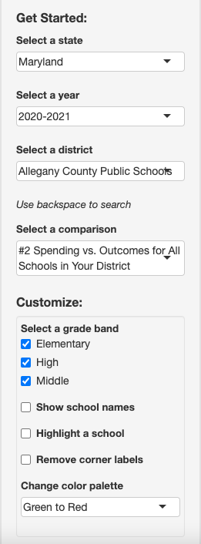
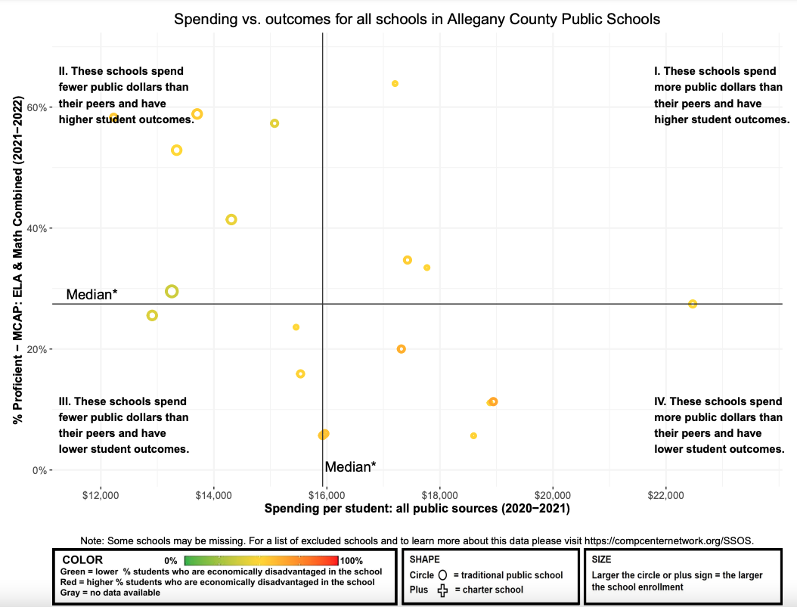
Examine outcomes in terms of spending. Use the SSOS tool.
Pace of
spending
Student
Outcomes
Source: https://compcenternetwork.org/ssos
Notes:
Jack
Another strategy for SEAs to consider that are tracking pace of LEA spending is to also focus on student outcomes.
One starting point, seen here, is the is the National Center School Spending and Outcomes Snapshot (SSOS) tool, which can plot school spending vs outcomes in your state. Our colleagues at the Edunomics Lab are happy to update spending and outcome data if you provide them with an Excel file.

Slide 38
Examine short- and mid-term outcomes while monitoring and designing grants
Pace of
spending
Inputs | Outputs | Short-Term Outcomes | Mid-Term Outcomes | Long-Term Outcomes | Available Data
 |  | What evidence do we have that we are on track to achieve our long-term outcomes?
What are the key requirements?
Student
Outcomes
Investment
Source: Evaluating the Impact of ARP/ESSER/ESF-Funded Programs Using Logic Models, National Comprehensive Center
Notes:
Barb
If you are already monitoring the pace of spending and student outcomes, then begin to get curious about the implementation of the interventions. Identify an intervention of interest and choose a few schools or agencies to learn from and with.
What evidence points to short-term and mid-term outcomes being early indicators of success? Is engagement increasing, chronic absenteeism decreasing? Are subgroups of students beginning to accelerate their achievement? Are districts or organizations building capacity for instruction improvement?
Once you have identified leading outcomes, work to determine and norm the inputs and outputs across contexts. These foundational practices will inform the necessary requirements for sustainability.
If you do not already, we recommend supporting districts and schools by providing them with a logic model template/format to use. Ideally, this is something used in not only ESSER work, but other grants that your team is offering.

Slide 39

Define a theory of action or the logic model as part of the System Strategy Return on Investment Approach
Questions to ask:
Based on research, what are the critical success factors to ensure this strategy results in the desired impact for targeted students?
What specific actions does this strategy require?
For how many targeted students and at which schools?
Source: System Strategy Return on Investment Approach, ERS
Notes:
Barb
A theory of action is a similar tool and ERS includes this as a key step in their guidance to help districts determine the system strategy return on investment. This SSROI approach is also something we will be sharing more about in the next universal webinar.
https://www.erstrategies.org/tap/return_on_investment_in_education

Slide 40
Pace of
spending
Communicate the "defined intervention" to audiences with influence through technical assistance
Student
Outcomes
Tutoring!
Presentations by LEAs to LEAs
Case studies by SEAs to School Boards, District Leaders, Community Advocates
Investment
2-hour small group learning,
3x per week, led by paraprofessionals
Communi-cations
& Scale
Notes:
Jack
SEAs can also play a role in helping to communicate successful interventions, particularly using trusted and well-connected voices
This could mean providing opportunities for districts to share their success at an upcoming all call for superintendents.
An SEA might also find ways to capture case studies – for instance, something as simple as a recorded Zoom interview – and get them in front of key audiences like school boards through the local school boards association.
<click> And rather than saying just tutoring
<click> Communicate the specific components of the intervention to better promote dissemination and replication

Slide 41
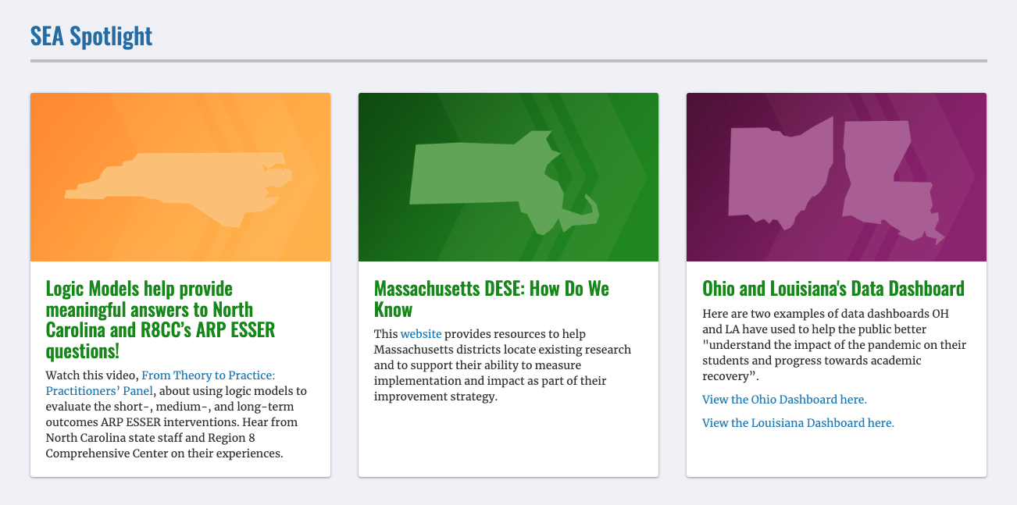
Find suggested resources associated with SEA levers within the Resource Portfolio
Source: https://compcenternetwork.org/ccnetwork-highlights/topic/8274/strategic-planning-continued-recovery
Notes:
Barb
The resources Jack and I have mentioned, along with others, can be found within the National Center's Strategic Planning for Continued Recovery resource portfolio. Please bookmark the link in the chat for future use. If you would like assistance in reviewing these options and tools within your own context, we are available for consultation conversations.

Slide 42
Announcements and Opportunities
Notes:
Jill

Slide 43
Here’s another look at the supports planned through the SPCR
Nov. 9 Nov. 30 Dec. 6 Jan. 11 Feb. 1 Apr. 4 Summer ‘24
Universal Webinars &
Resource Portfolios
Determine impact of prior investments
Prioritize efforts for ongoing recovery & transformation
Achieve sustainability through financial planning
Ensure access & opportunity for all
Communicate impact of investments
Support/sustain systemic capacity building
Individualized Supports
Individual SEA Coaching
Individual SEA Consultations
Individual SEA Consultations
Targeted Supports
We are planning to offer targeted opportunities for cross-SEA team collaboration starting in late fall 2023 and continuing into 2024. The nature and frequency of these targeted supports will be informed by needs identified through SEA team individual consultations
Notes:
Jill
In addition to the universal webinars and aligned resource portfolios, there are other supports:
Individual team consultation conversations following webinars
Individual team coaching with finance experts
Targeted opportunities for SEA Teams to engage in cross-SEA collaboration – more details to come soon!

Slide 44
We hope you’ll engage with these different supports in the coming months
Individualized Consultations with SEA Teams
  60-minute strategy session to share context, identify needs, and identify potential capacity-building efforts related to determining impact of investments
Cross-SEA Team Collaboration
60-minute facilitated conversations among interested SEA teams on a shared topic
Webinars
  November 30, 2023, 4 p.m. ET: Webinar #2: Prioritize Efforts for Ongoing Recovery & Transformation
  December 6, 2023, 4 p.m. ET: Webinar #3: Achieve Sustainability Through Financial Planning
Notes:
Jill

Slide 45
Please share your insights about today's presentation and express interest in additional SPCR supports using the Zoom poll.
Notes:
Jill

Slide 46
This presentation is in the public domain. While permission to reprint is not necessary, publication should be cited. The presentation is prepared by the National Comprehensive Center under Award #S283B190028 for the Office of Program and Grantee Support Services (PGSS) within the Office of Elementary and Secondary Education (OESE) of the U.S. Department of Education and is administered by Westat. The content of the presentation does not necessarily reflect the views or policies of the PGSS or OESE or the U.S. Department of Education nor does mention of trade names, commercial products, or organizations imply endorsement by the U.S. Government. © 2023 Westat.

